Slide 1
Getting started with youHQ
Professional wellbeing software for schools bought to you by Life On TimeTM

Slide 2
Contents
Why youHQ
WHY DO WE EXIST?
WHO ARE WE?
WHAT DO WE DO?
Introducing youHQ
FOREWORD
STUDENT ENGAGEMENT
STUDENT SUPPORT
Introducing youHQ to your team
HOW TO
SCRIPT TO TEAM
WHEN TO IMPLEMENT
SCRIPT TO ADMIN TEAM
SCRIPT TO PARENTS
P3
P4
P6
P7
P9
P10
P12
P14
P16
P17
P18
P19
P20
P21
Introducing youHQ to your class
SCRIPT TO CLASS
Introducing youHQ Lesson plans
Session 1 Logging in, intro genie and mood check in
Session 2 What are values and what are your values?
Session 3 Setting goals and actions in line with my values
Session 4 Avatars and exploring the dashboard
Session 5 Achievements and GOALd!
Session 6 Snapshot report, Ideas, and Journal
FAQs
P22
P23
P26
P28
P30
P32
P34
P36
P38
P40

Slide 3
Why youHQ?

Slide 4
There is a global problem with our children’s mental health
WHY DO WE EXIST?
Five children in a classroom of 30 are likely to have a mental health problem.
50%
of all mental health problems start by the age of 14
2/3s
of young people prefer to access mental health support without going through their GP

Slide 5
Young people shouldn’t have to wait for a mental health crisis to get help.
WHY DO WE EXIST?

Slide 6
youHQ highlights those in need and inspires everyone to succeed. The digital pastoral hub for schools that helps students and teachers flourish.
WHO ARE WE?

Slide 7
WHAT DO WE DO?
Reduce Risk
Save Time for Tutors
In an ever increasing busy and high-pressured teacher role it’s understandably difficult to detect all potential mental health emergencies.
We believe in prevention over cure and that keeping constant eyes on your students’ wellbeing is the first step in your safeguarding processes.
youHQ was developed by education and psychology experts, and refined through in-school testing to quickly help schools identify those who may need additional support to AVOID the threat of mental health crises.
At a glance, our interactive Tutor dashboard let’s you look at every possible angle of the school and see intuitively how the mood is across the board. With minimal clicks you can dive into smaller classes, focus groups or individual students and quickly surface insights into student mood, wellbeing, and anxiety levels.
Wellbeing insights at a glance
Quickly export tailored reports
AI-led smart resources for students and teachers
Reduce safeguarding related admin through automated systems
Discover meaningful relationships
Inspire Purpose
youHQ is uniquely changing the way schools care for their people by incorporating effective mood and wellbeing monitoring with therapeutic CBT-style tools.
We are adamant that if students can understand the power of ‘values’ and learn to set goals towards these values, they will become more rounded individuals with purpose with a personalized definition of happiness and success, despite the social pressures they experience each day.
Allows students to self-reflect
Gives teachers the insight to identify those students who need support
Gives students therapeutic tools to self-care

Slide 8
We make your school ‘APPIA’
WHAT DO WE DO?
Awareness
Prevention
Positive habits
Intervention
Alert
Help students raise their emotional intelligence
Allows students to silently raise flags
Build trusting relationships with their tutor
Gives SLT an overview of mood by individual, class, whole school, and even by individual schools for MATs and Councils*
Dedicated support page where students can silently reach out
Resources updated weekly by youHQ
Cover a wide range of mental health conditioning
Fully customisable resource area allows schools and teachers to promote preferred content
Can be aligned to School’s core values
Help students to identify what matters most to them (their values)
Introduction to SMART life goals
Engagement encouraged through gamification and reward (GOALd)
Easy to find ‘red-flags’ at individual level to whole-school view
Create Focus Groups for extra care and support
Student-Teacher Conversation log to help coordinate intervention action plans.
Student low mood tutor email notification
Swift and focused attention brought to all required parties
Integration with the UKs leading safeguarding specialists
Informed safeguarding

Slide 9
Introducing youHQ

Slide 10
Foreword
INTRODUCTION
As much as we’ve tried to make youHQ intuitive and self-serving, we appreciate that learning a new digital tool can take time.
Since we know how much you value the progress of your class, we just want to remind you that your efforts now will save time in the long run.
youHQ will help tutor productivity, ease work-related stress, and offer an extra pair of hands to help identify students who may need more support, by automating pastoral-related administrative tasks.
The next few pages provide a script that you can read verbatim from this PDF, or you have the option to download and print them if you find that easier.

Slide 11
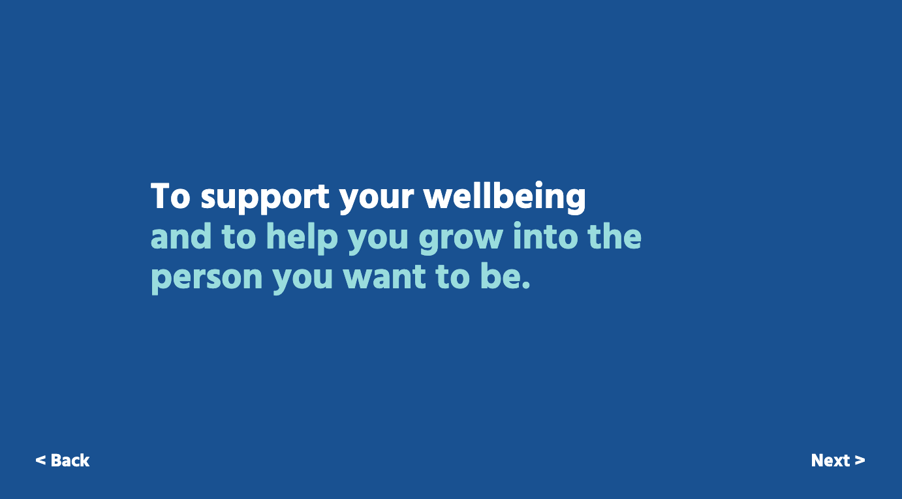
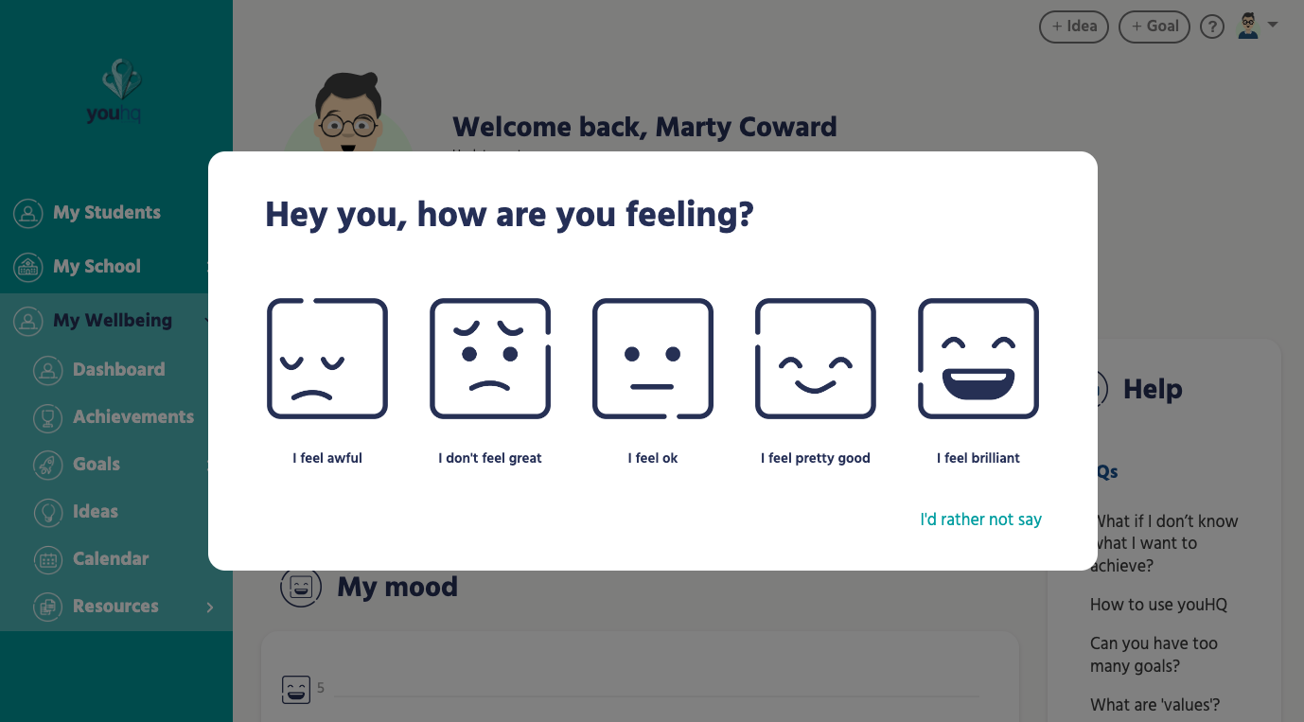
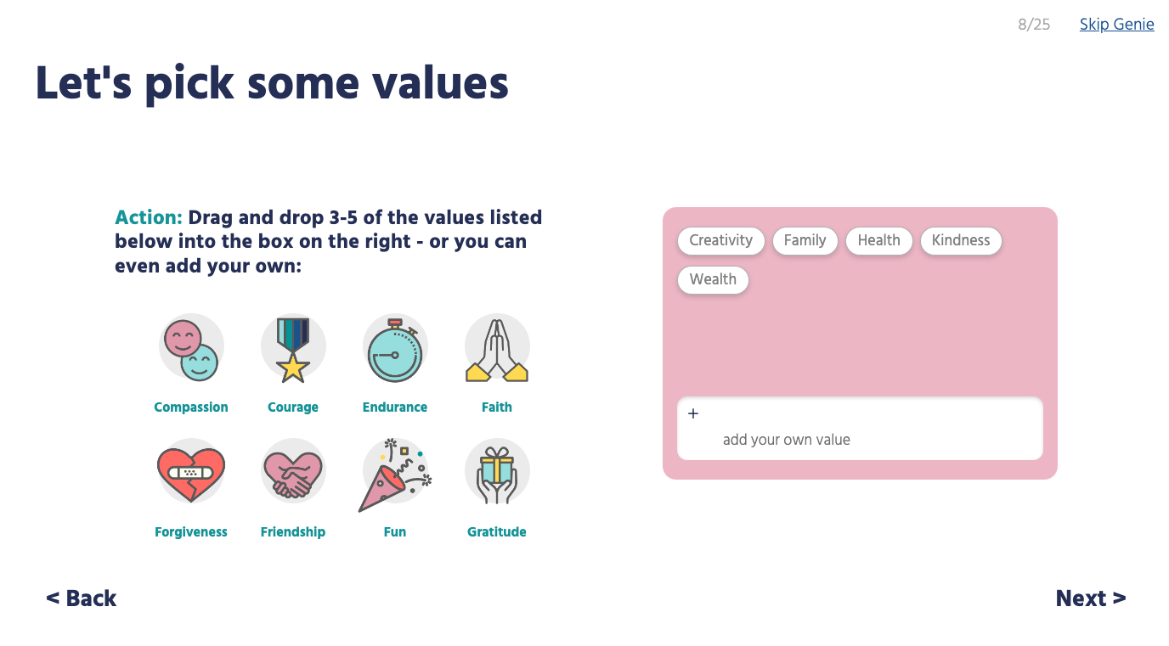
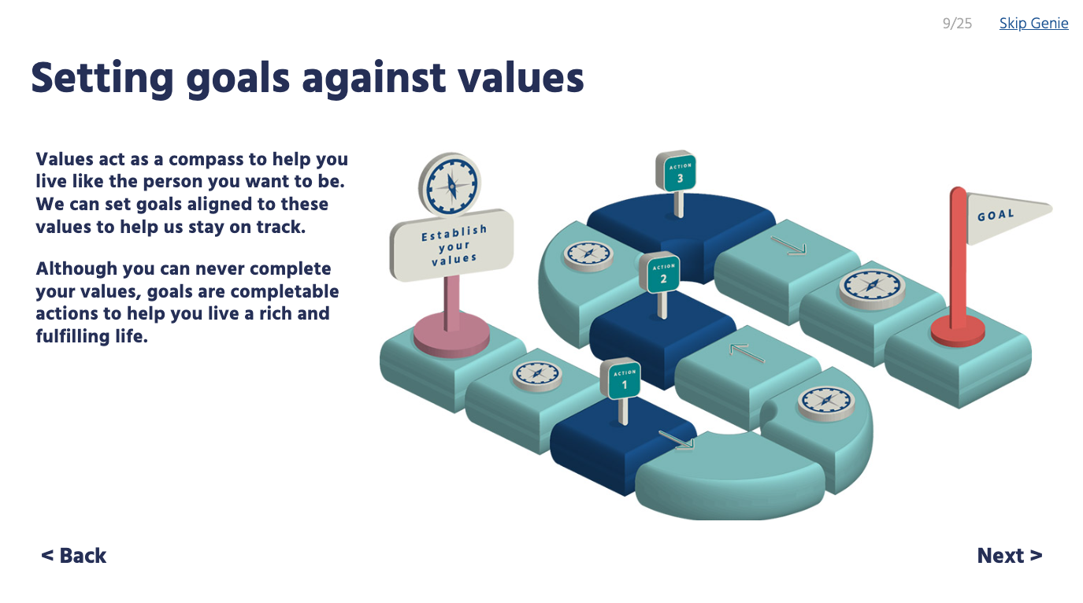
Foreword
INTRODUCTION
youHQ getting started genie
Once you’ve introduced the platform and watched our intro videos it is recommended that you take the whole class through the ‘youHQ getting started genie’.
This will load automatically the first time students log in.
This is a fantastic classroom lesson, as we introduce the idea of values and values-based goal setting.

Slide 12
Student engagement
INTRODUCTION
We want to ensure that youHQ is used by students because they WANT to, not because they must.
Learning about self-reflection, values, and goal-setting is a great way for people to contemplate their behaviour and its consequences. It will help them to shape their future path towards happiness and their definition of success.
To get the full benefits of youHQ, we must make reflection a habit. For this reason, along with your own motivation and guidance, we’ve also built in playful aspects to create and sustain habits.
Personalise with avatars
Having the ability to build characters within youHQ that reflect how the student sees them self is a fun way to build engagement. And if they’re enjoying the platform, the more likely it is that they will use it.
So, what will it be, spiky hair, pink t-shirt, a neck tattoo!?
Customising values
It’s important for students to learn what matters to them most. We call these indicators ‘values’.
By learning about values students can start to live their life towards a personalised definition of success.
The closer they live their life to these values the easier it is to help them feel good about themselves.
Build positive habits with GOALd
We make it easy to form a habit of personal development with simple game-like rewards. Every time students do something that will help them, they get something back.
Note: We’re looking at ways for your students to spend GOALd - if you have any suggestions, please contact a member of the team.

Slide 13
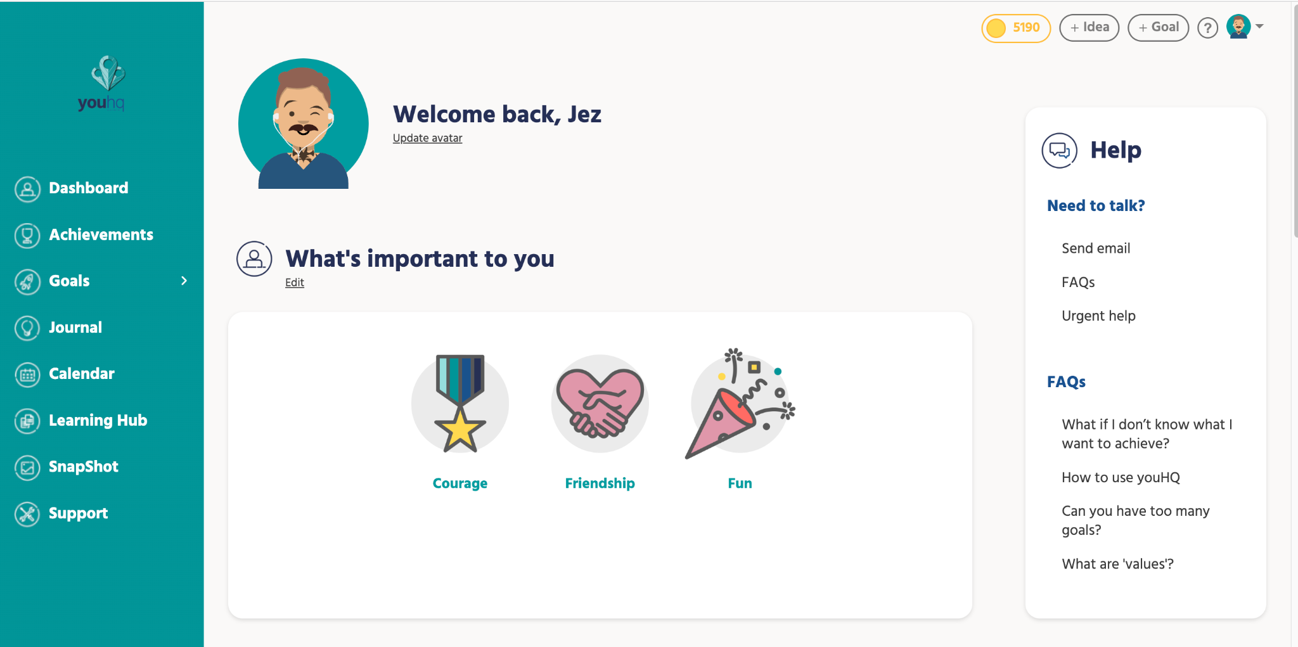
Student engagement
INTRODUCTION
Find GOALd here
Personalise avatars here
Personalise avatars here
Find GOALd here
Customise values here

Slide 14
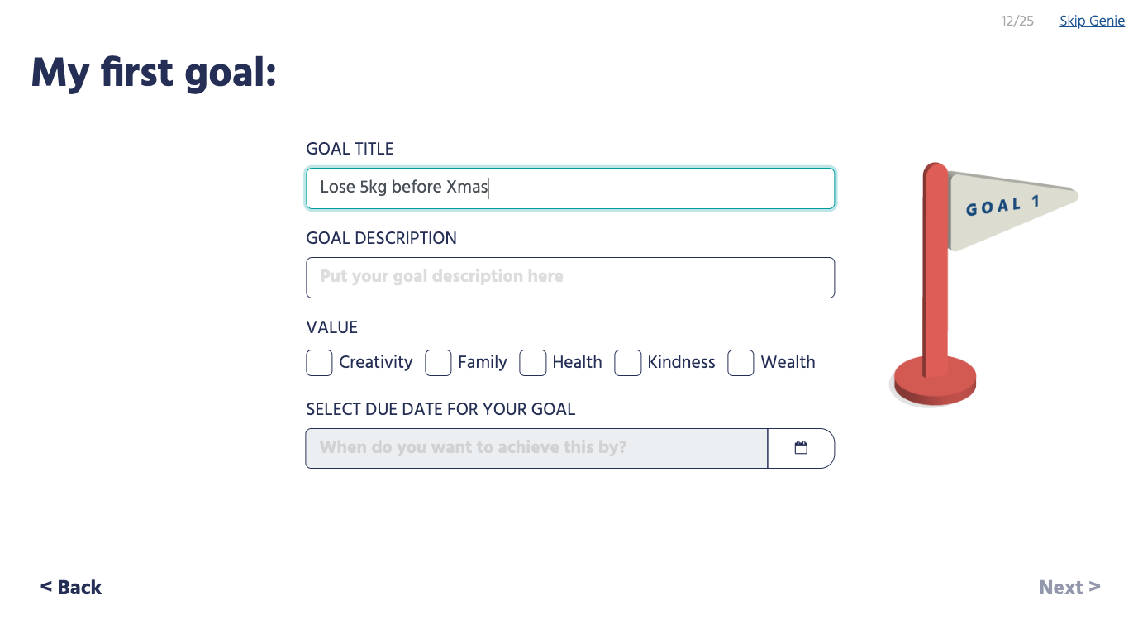
Student support
INTRODUCTION
If you’re new to values and goal setting it can take some time to get to grips with it. And that doesn’t just mean the students. It can be tricky for tutors too, be that from writing their own values and goals to understanding how to best support their students’ efforts.
That’s why we developed the ‘goal genie’. After login, this will be the first thing students see. It will auto load and start to walk the audience through the platform and introduce core elements such as values and goal setting. Once completed, students can revisit the ‘goal genie’ whenever they like.

Slide 15
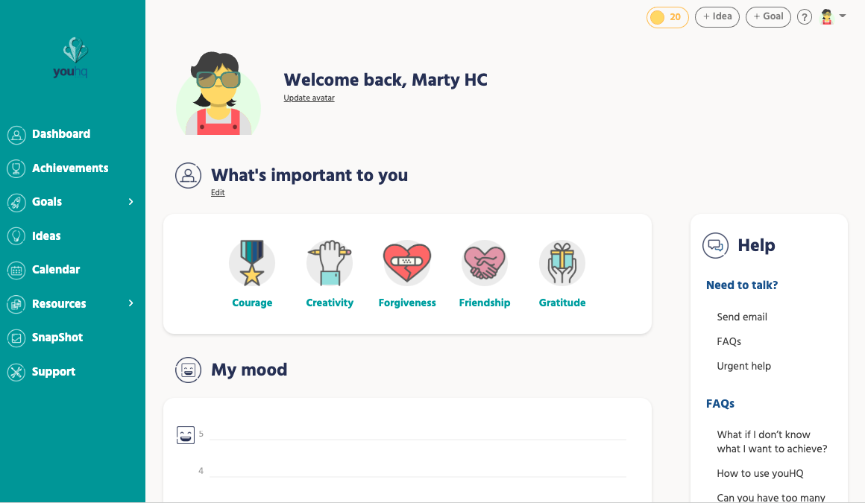
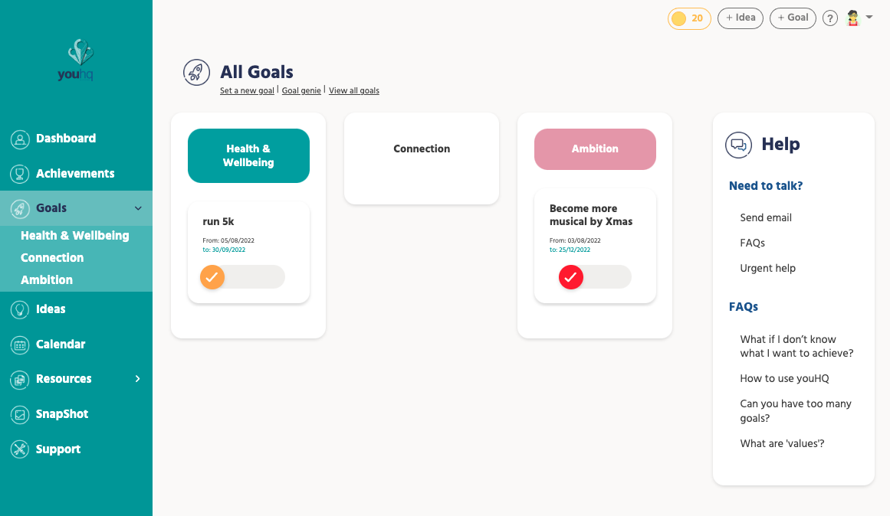
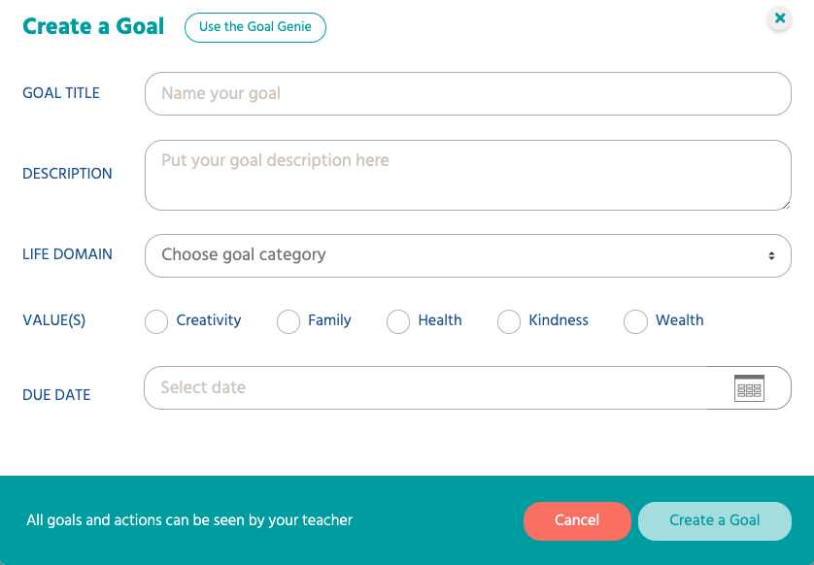
Student support
INTRODUCTION
1
= where to launch ‘new goal’
2
= where to launch ‘goal genie’
1
1
2
2
Goals dashboard
New goal pop up
Main dashboard

Slide 16
Introducing youHQ to your team

Slide 17
How to introduce youHQ to your team
INTRODUCTION
Option 1 My team all have 1 hour
Organise a face to face or remote training call for your pastoral leads and tutors where the youHQ team can introduce and train your team on the platform.
Please email jez@lifeontime.co.uk to arrange a date and time if you haven’t done this already.
Option 2 My team all have 30 mins
Organise a remote call where the youHQ team can introduce the platform to your staff..
You can book this here https://calendly.com/youhqdemo/youhq-demo
Option 3 My team have no time!
We strongly recommend option 1 or 2 but if you really have no time then you can use the email template and training decks to introduce the platform to your team (the training decks are great ‘top up’ info anyway or for anyone that missed the initial training.

Slide 18
Introducing youHQ to your team
INTRODUCTION - SCRIPT
Dear xxxx,
I hope this email finds you well.
As you may have heard we are implementing a new wellbeing and personal development platform in school. The platform is multi-functional and will help you build strong, trusting, meaningful relationships with your pupils. Please go through the staff training deck below (you can cherry pick the videos you may need help with) before you roll out with your tutor group/class.
For more information please see the youHQ website www.youhq.co.uk
Staff training deck (30 mins)
When are we expected to use the platform with our classes?
We aim to send all login details on the DATE and for it to be used in tutor time/xxxx lessons. Attached are optional scripts to help you introduce the platform to your classes and to facilitate 1-2-1 conversations between staff and students.
The platform is available on PC or laptop via any web browser but also from the app store and so your students can use on their phones and tablets.
If you have any questions or concerns, please let me know.
Kind Regards
xxxxxxx.

Slide 19
Implementing youHQ
INTRODUCTION
Form time
We recommend using youHQ as a form time activity/starter/finisher. As one of the main benefits of youHQ is enabling tutors to build strong relationships with students, form times have been proven to be effective way to utilise youHQ. We recommend using the platform 1-2 times per week for 15-30mins.
If students don’t have devices you can use our printable ‘Goal genie’ and ‘idea pads’ PDFs and students can then use the platform once at home.
Dedicated youHQ lesson (as part of your PSHE programme)
If form times are full or too short to use youHQ, many schools dedicate weekly/bi-weekly lesson’s to youHQ as part of PSHE.
If your students do not have devices, schools can use ICT suites or our printable ‘Goal genie’ and ‘idea pads’ PDFs with students then being set homework to login and use youHQ at home.
Homework activity
If your school has no devices and no time in the curriculum it can work well as a homework activity.
The platform is intuitive so students can use it without being lead by a teacher or tutor. Students need to be instructed to use it once per week for 30 mins at home and tutors can monitor its usage using the admin panel.
Tutors can check-in on the wellbeing and personal development score and can set up 1-2-1 conversations in school if the platform highlights an issue.

Slide 20
Introducing youHQ to your Admin/Pastoral team
INTRODUCTION - SCRIPT
Dear xxxxx,
I hope this email finds you well.
As you may have heard we are implementing a new wellbeing and personal development platform in school. The platform is multi-functional and will help us track and monitor student and staff wellbeing, provide invaluable personal development evidence and character education and create outstanding pastoral and safeguarding practice.. Please go through the admin training deck below (you can cherry pick the videos you may need help with) before you start to use it to monitor students in your year/house.
For more information, please see the youHQ website www.youhq.co.uk
Admin training deck (30 mins)
When are we expected to use the platform?
We aim to send all login details on the DATE and for it to be used in tutor time/xxxx lessons. Attached are optional scripts to help tutors and class teachers introduce the platform to their classes and to facilitate 1-2-1 conversations between staff and students. The advice is to at least log in once a week and monitor the weekly admin email to track any students reaching out for support.
The platform is available on PC or laptop via any web browser but also from the app store and so students can use on their school devices phones and tablets.
If you have any questions or concerns, please let me know.
Kind Regards
xxxxxxx

Slide 21
Introducing youHQ to parents
INTRODUCTION - SCRIPT
Dear Parent,
We are looking at different ways to develop individual personal development for our students and we would like to trial the use of a wellbeing and personal development desktop and mobile application called ‘youHQ’ (website www.youhq.co.uk).
We believe this is more important than ever at this time so we can:
get to know new students quickly
monitor wellbeing effectively
use goal setting and the online resources to help improve mental health and self-esteem
The online platform is designed to use values-based goal setting to help with focus, motivation and confidence but also to help students think carefully about mindfulness, resilience, physical, mental and social health and how to set and break down meaningful goals to be successful in different aspects of life.
To do so we will need to use the students’ school email address which will be shared with the team at youHQ. They will then have their own log in details, which we will use to monitor goals and well-being.
Kind regards
xxxxxx

Slide 22
Introducing youHQ to your class

Slide 23
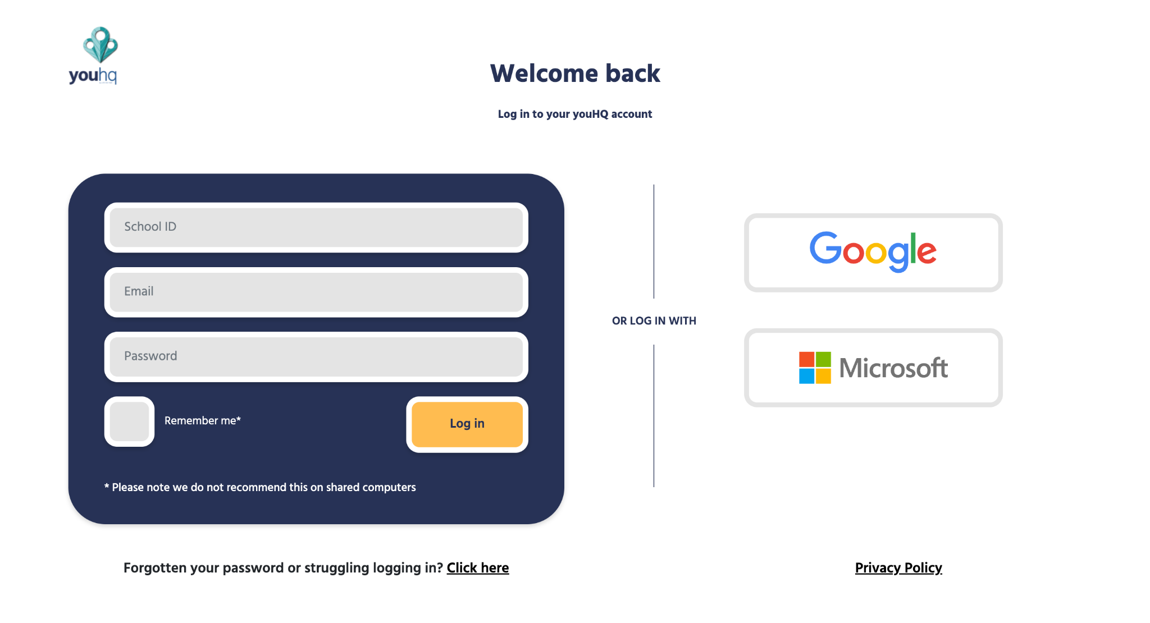
Introducing youHQ to your class
INTRODUCTION - SCRIPT
Today we are introducing a new app which will help us support your wellbeing and personal development. The app is called youHQ and can be accessed on pc, laptop, mobile or tablet. It’s also available to be downloaded on your tablet and mobile through Apple’s App Store and Google play.
Here is a short video to introduce it:
Intro to youHQ
You will receive your login details in a few minutes/You should have received an email from life on time with your login details.
The app will track your wellbeing by asking you to answer a short survey every few weeks and asking you to log your mood every time you login.
These are not tests and you won’t be graded or judged by the results. The school and I will use these results to help us make sure you are all doing ok.
The platform has lots of resources which we advise you to watch either in class or in your free time. There is also a really cool ‘Goal Genie’ which pops up when you first login and can help you start to think about and plan the things you might want to achieve and type of person you want to become.
[NOTE TO TUTOR] The video below is on the platform – they just need to search for ‘How to create and set values and goals’ you can play this before they login or this can be the first video you ask them to watch.
Student first login
So, let’s get started by logging in!
Login screen looks like this and can be found via youHQ.co.uk, click ‘login’ button in the top right of the site

Slide 24
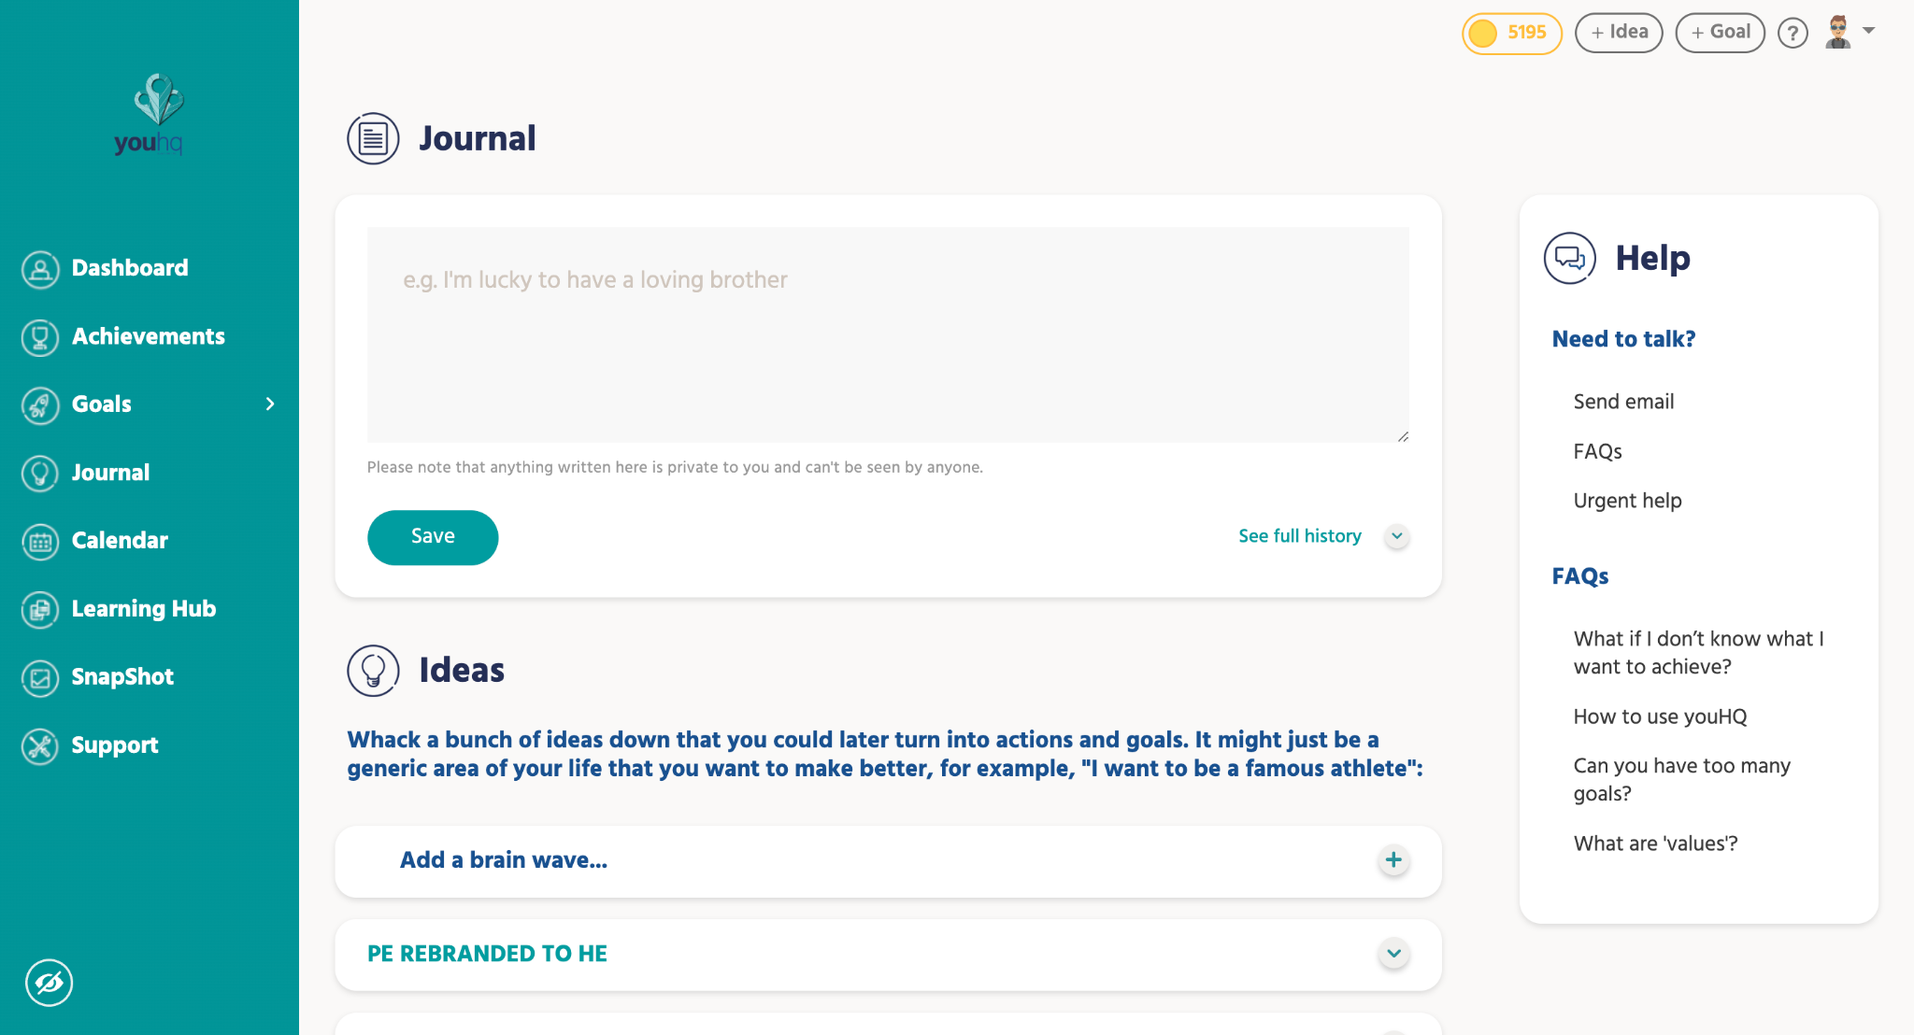
Introducing youHQ to your class
INTRODUCTION - SCRIPT
Creating a Journal entry or Idea
If you If you have been through the Goal Genie and aren’t sure of any goals, we suggest going to the Journal section as this area allows you to note down any thoughts or ideas of goals and ambitions you may have.
There is NO such thing as bad idea! Think about some of the things you want achieve or maybe what you want to do when you leave school or even things you might want to achieve by the end of the year or this month – think big!
Turning your Idea into a Goal
If you are confident about turning an idea to a goal, then you can do that by ‘clicking on the convert idea into goal button’. You can now select the value the idea should sit within and schedule when you want achieve it by.

Slide 25
Introducing youHQ to your class
INTRODUCTION - SCRIPT
Breaking your goal into actions
One of the easiest ways of making your goals achievable is breaking them down into smaller bite size actions.
You can now do this from the goals area by adding actions to the goal.
These are smaller short-term objectives you need to do to make your goal achievable.
Example 1
Your goal is to become a professional athlete
What are the smaller actions you need to complete to achieve this?
Research local clubs to join
Create training schedule and stick to it
Ask parents/friends to help
Get a professional coach
Example 2
Your goal is to get a B in Maths
What are the smaller actions you need to complete to achieve this?
Ask teacher for help
Spend an extra hour per week on Maths on a Wednesday
Ask parents for extra help

Slide 26
Introducing youHQ Lesson plan templates

Slide 27
Introducing youHQ to your class
LESSON PLAN TEMPLATES
Session 1 Logging in, intro genie and mood check-in (15-20 mins)
Session 2 What are values and what are your values? (15-20 mins)
Session 3 Setting goals and actions in line with my values (15-20 mins)
Session 4 Avatars and exploring the dashboard (15-20 mins)
Session 5 Achievements and GOALd! (15-20 mins)
Session 6 Snapshot report & Ideas (15-20 mins)

Slide 28
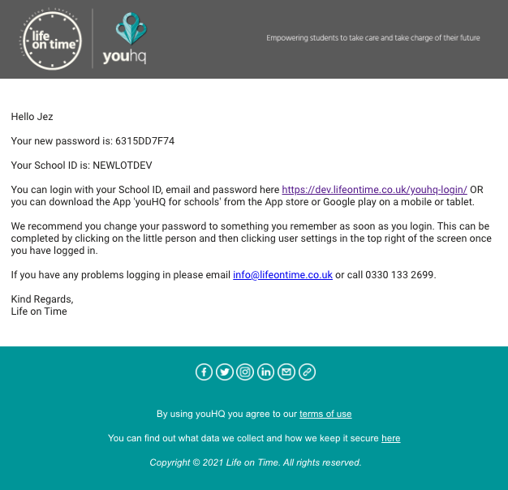
LESSION 1 (15-25): Logging in, intro genie and mood check in
What will you be able to do by the end of the session?
0-5 mins
5-10 mins
Log in to youHQ successfully
Read through what youHQ is and why your school is passionate it will help you
Register your current mood and a reason why you think you might be feeling that way
Find your log in email (search for “life on time” and check your junk folder). Click on the link in the email or if you are using youHQ as an app on your device, open the app and enter the details as they appear. If you copy and paste the password, make sure there are no spaces, or it won’t work!
Go through the first 5 slides explaining what youHQ is, how the school will use it and how it will help with your wellbeing.
6888DD5D54
NEWSCHOOL
Notes:
Session 1
https://www.loom.com/share/7782ecf477084533a0dae61302d68cf2
Session 2
https://www.loom.com/share/9840a6d58b064eef8a3d45a55529fe92

Slide 29
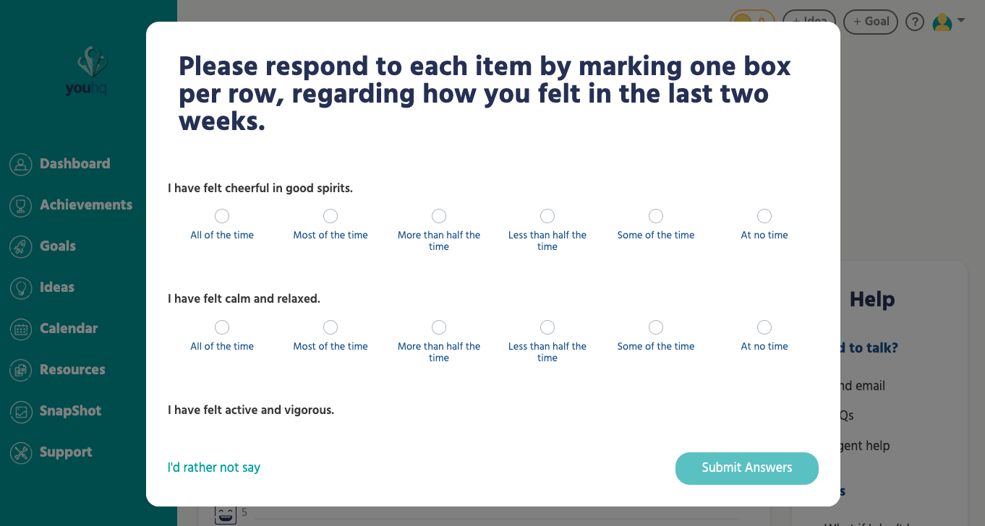
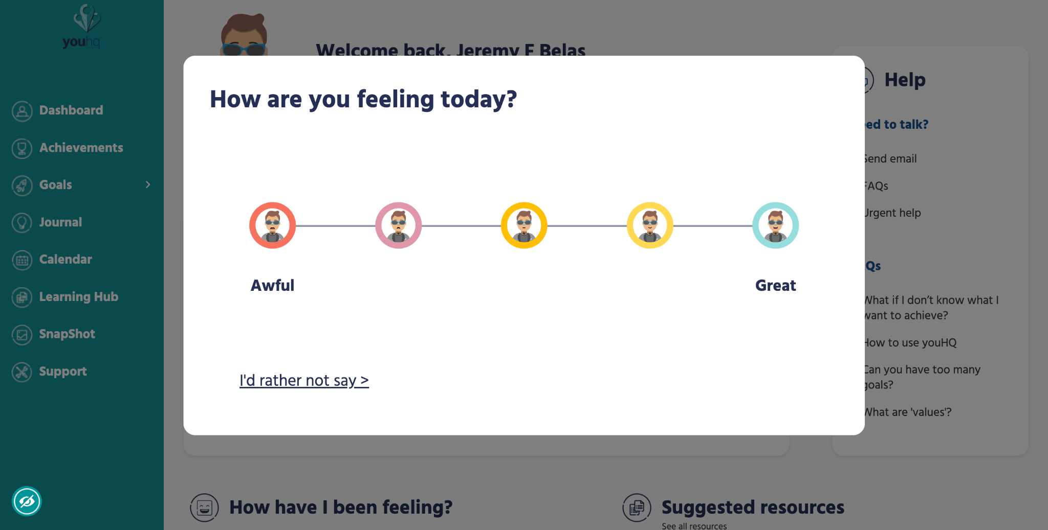
LESSION 1 (15-25): Logging in, intro genie and mood check in
10-20 mins
20-25 mins
Click on Launch surveys and complete the WHO-5 (World Health Organisation, 5 question) wellbeing survey. For each question select the most accurate answer from “All the time” all the way to “at no time”. It’s important you are honest. Remember, this is not a test.
When this is done the ‘mood check-in’ will automatically appear. Select the mood emoji image that best reflects how you are feeling right now. Think about a possible reason why you might be feeling this way. This is called emotional intelligence and is a skill (many adults struggle with this!). If you can develop this now it will help you mentally in the future (we are improving your mental fitness, you’re welcome)!
If you complete this, why not play around with the avatar feature, help one of your friends or perhaps start a group discussion on personal reflection with your tutor or teacher;
What’s the point? Does it help? Is it a skill we should all have? Is it easy?
Once your tutor/teacher is happy then;
Click ‘skip genie’ in the top right of your screen
Click on the drop-down arrow and go to ‘profile settings’. Change your password to something memorable and keep a note of it somewhere safe!
logout by clicking on the same drop-down arrow by the avatar on the top right of your screen
That wasn’t too bad, was it?! Well done!
Watch intro video
CLICK TO PLAY
Notes:
Session 1
https://www.loom.com/share/7782ecf477084533a0dae61302d68cf2
Session 2
https://www.loom.com/share/9840a6d58b064eef8a3d45a55529fe92

Slide 30
LESSION 2 (15-25): What are values and what are your values?
What will you be able to do by the end of the session?
0-5 mins
5-10 mins
Read through the next two slides on self understanding and values and try to take in what values are. On the third slide, have a go at dragging and dropping or coming up with your own 3 to 5 core, personal values. These are words that sum up who and what you want to be (use the examples as a guide)
Understand the term ‘values’
Make an attempt at setting your core, personal values (min 3, max 5)
Register your current mood, emotions and a reason why you think you might be feeling that way
Earn GOALd by engaging with a resource
Log in (use your new password from last session). If you didn’t change your password, search ‘Life on time’ in your emails and use the automatically generated one (but change it once logged in by clicking on drop down arrow, top right, profile settings)
Once logged in, complete your mood check in, accurately logging how you feel right now, what emotions that brings up and a possible reason why. Maybe watch a suggested resource if you have time?
After that, scroll down from the dashboard page and take notice of the different areas (the avatar, the ‘what’s important to me’ section, the help area on the right etc. Scroll down passed the mood graph (you should be able to see your mood from today and last time), some suggested resources, until you see ‘Recent Goals’. Click on ‘Goal genie’.
Notes:
Session 1
https://www.loom.com/share/7782ecf477084533a0dae61302d68cf2
Session 2
https://www.loom.com/share/9840a6d58b064eef8a3d45a55529fe92

Slide 31
LESSION 2 (15-25): What are values and what are your values?
10-20 mins
20-25 mins
Click ‘Skip Genie’ and scroll back to the top of your dashboard. You should notice your core values appearing under the avatar where it says, ‘What’s important to you’. These can be changed at any point and there’s no right or wrong answer.
Read them again and think about the following questions:
What do I love to do?
Why do I love to do it?
Why do I think this is important?
(e.g., I love playing football because being physically fit makes me feel good, and being fit physically makes me feel fit mentally, which is important to overall happiness in my life)
Review your values and make any changes you may want to make.
Click on ‘Support’ (located at the bottom left of the screen. This is an area where you can reach out to you tutor, head of year or staff member you are working with if you’re struggling in anyway. There are also links to some of the best young person’s mental health charities in the country on the right. This is between you and the appropriate member of staff only.
If you complete this, why not help one of your friends who may be struggling. Maybe you can update your avatar if you have time or share your values in a group discussion and why you chose them. Logout by clicking on the drop-down arrow by the avatar on the top right of your screen.
Week 2 in the locker! Well done!

Slide 32
LESSION 3 (15-25): Setting goals and actions in line with my values
What will you be able to do by the end of the session?
0-5 mins
5-10 mins
Understand the term SMART goals
Set at least one SMART goal linked to the main life domains and your personal values
OPTIONAL: Set an action to help you achieve one of these goals
Log in (use your new password from last session). If you didn’t change your password, search ‘Life on time’ in your emails and use the automatically generated one (but change it once logged in by clicking on drop down arrow, top right, profile settings)
Once logged in, complete your WHO-5 survey (pops up every two weeks) and your mood check-in, accurately logging how you feel right now and a possible reason why.
After that, scroll down from the dashboard page and take notice of the different areas until you see ‘Recent Goals’.
Click on ‘Goal genie’. Scan through the first 3 slides (you can review and edit your values if you like). Read slides 4, 5 and 6 on SMART goals and what they are.
Set your first goal. Think about something specific you want to achieve. This could be personal, academic, ambition or anything in between. These are YOUR goals, not your parents or schools.
Try to make the goals as specific and measurable as possible (e.g., instead of ‘get better at football’ try ‘attend my club’s training sessions consistently’.
In ‘goal description’ you might write ‘attend both sessions weekly and train with intensity’. Select the most relevant personal value (don’t worry if it doesn’t fit exactly) and select an end date for that goal (NB a good rule of thumb is a 4–6-week goal, mid term).
Click next and pick a general area this fits within (most schools use Health and Wellbeing, Connection and Ambition but yours may use their own school areas). The goal above could fit into any depending on why the individual wants to train more at football. If it’s to be a professional player then they may choose ambition, if it’s for fitness then health and wellbeing and so on.
Click next.
Notes:
Session 1
https://www.loom.com/share/7782ecf477084533a0dae61302d68cf2
Session 2
https://www.loom.com/share/9840a6d58b064eef8a3d45a55529fe92

Slide 33
LESSION 3 (15-25): Setting goals and actions in line with my values
10-20 mins
20-25 mins
The next screen asks if you’d like to set an action for this goal.
These are things that help you achieve the goal (steppingstones to get to your destination). In the example above this might be ‘Train twice this week with high intensity’.
You do this by clicking ‘make an action’. This is optional and a real skill. If you don’t want to do this, click ‘skip action setting for now’ and you will return to the main dashboard.
If you set one, add the wording, select the first time you will complete the action and either select ‘add another action’ or ‘no more actions needed’
When you’re done take a moment to notice the congratulations page! Click done and return to the main dashboard.
If you complete this, why not help one of your friends who may be struggling. Maybe you can update your avatar if you have time or share your goal/action in a group discussion and why you chose them.
Logout (please).
Oh, you’re good…you’re very good!
Notes:
Session 1
https://www.loom.com/share/7782ecf477084533a0dae61302d68cf2
Session 2
https://www.loom.com/share/9840a6d58b064eef8a3d45a55529fe92

Slide 34
LESSION 4 (15-25): Avatars and exploring the dashboard
What will you be able to do by the end of the session?
0-5 mins
5-20 mins
Edit your Avatar (if not done already)
Navigate around the dashboard
Choose a resource to watch, listen to or read (or search for a good resource online linked to positive wellbeing and mental health)
Log in. Once logged in, complete your mood check in, accurately logging how you feel right now and a possible reason why.
After that, take a moment to update your avatar. Click on the drop-down arrow in the top right, ‘update avatar’ (add a cool hairstyle, funky glasses, even a neck tattoo)!
Now you’re going to fully navigate around the dashboard!
On the main dashboard page, scroll down and interact with each area (review your values, click on the ‘Help’ and ‘FAQs’ section. Click back on dashboard on the top left each time.
Look at your mood graph. What sort of profile do you have? Roller Coaster? Always up? Always down? In the middle? What could this mean (be curious, it’s a great quality)!
Notice the suggested resources. If you’re allowed (and you have headphones) listen or watch one of the shorter ones available (we hope they inspire you)!
Look at your recent goals from last week. Does it/they need updating? Have you completed the action if you set one? If so, click on it and edit the goal/action or click the tick to complete it. Maybe add another? Or delete it and start again. It’s all up to you!
Click back on ‘dashboard’ (top left) and scroll down to ‘Tables and Charts’. Take a look at your achievement graphs and charts. Note any goals or actions due or upcoming.
Finally, click on my schedule and see your goals and actions in your youHQ calendar. If they are red, they are overdue and may need reviewing
Notes:
Session 1
https://www.loom.com/share/7782ecf477084533a0dae61302d68cf2
Session 2
https://www.loom.com/share/9840a6d58b064eef8a3d45a55529fe92

Slide 35
LESSION 4 (15-25): Avatars and exploring the dashboard
20-25 mins
If you complete this, why not help one of your friends who may be struggling?
Have you watched, listened to or read one of the resources?
Can you share the takeaways with the group?
You are becoming a master of youHQ!
Logout (please).
Well done!

Slide 36
LESSION 5 (15-25): Achievements and GOALd!
What will you be able to do by the end of the session?
5-20 mins
Understand how to earn GOALd
Be able to complete goals and actions
Know how to attach evidence to a completed goal
You can earn GOALd (our youHQ currency) when you use the app, live by your values and complete your goals!
Click on ‘Dashboard’ on the left of the screen
Notice how much GOALd you have (you earn it for your first mood and WHO-5 check in and any goals and actions you’ve set or completed). Read the breakdown area to see how much you’ve earned and if any is pending…
Click on ‘Goals’ on the left-hand side. Review your goals and actions. Have you completed any since week 1? If you’d set SMART goals for 4-6 weeks, you may have done or could be close?
If you think you’ve completed a goal, make sure any actions are ticked off underneath and click on the green tick that says ‘mark this goal as complete’
Notice the screen that pops up congratulating you! You can now attach any evidence you might have to prove that goal has been completed (N.B. please choose aspirational, mid term goals. Goals such as ‘be kind’ are great but difficult to evidence. Re-framing this to ‘show 3 acts of kindness this month’ is more specific and your actions could reflect this i.e.,
Complete charity run
Hoover the house every weekend
Volunteer to help run football club. A simple email from an adult, picture or link to a website would be great evidence of this. Add a message to your teacher too and wait for approval.
0-5 mins
Log in. Once logged in, complete your WHO-5 (pops up every two weeks) and your mood check in, accurately logging how you feel right now and a possible reason why.
Notes:
Session 1
https://www.loom.com/share/7782ecf477084533a0dae61302d68cf2
Session 2
https://www.loom.com/share/9840a6d58b064eef8a3d45a55529fe92

Slide 37
LESSION 5 (15-25): Achievements and GOALd!
20-25 mins
If you complete this, why not help one of your friends who may be struggling? Have you watched, listened to or read one of the resources? Perhaps click on ‘Snapshot’ or ‘Ideas’.
Logout (please).
The force is strong with you!
Notes:
Session 1
https://www.loom.com/share/7782ecf477084533a0dae61302d68cf2
Session 2
https://www.loom.com/share/9840a6d58b064eef8a3d45a55529fe92

Slide 38
LESSION 6 (15-25): Snapshot report, Ideas, and Journal
What will you be able to do by the end of the session?
5-10 mins
10-20 mins
Go to the ‘Snapshot’ tab on the left-hand side of the screen.
Click on this to bring up your personalised, youHQ snapshot report
Notice your information, values and class at the top
You should be able to see which ‘level’ you have reached (Bronze, Silver or Gold). Engagement with the platform earns you GOALd; the more GOALd you collect, the higher the level you reach.
Look at your personal stats on goals, actions and ideas created and your % completion rate so far.
Scroll down to see your current mood, average mood and mood profile graph
At the bottom you can see your wellbeing score over time (this is the score from your WHO-5 survey you complete every 2 weeks)
Click ‘Close’ at the top of the screen
Navigate to the ‘Journal’ Section on the left-hand side. Is there anything you want to write about. Perhaps an Idea you want to record? Something you’ve thought about doing recently but haven’t quite got there?
What about a career that you’re interested in?
A conversation you want to have with something, a feeling you’ve been having or something you want to know more about?
This isn’t seen by anyone else and is a chance for you to reflect and think.
Try adding an idea to this area adding some simple notes underneath
Click ‘create idea’ and notice it appears in your ideas section
You can edit this idea, delete it or convert it into a goal when you’re ready to
Know how to access your ‘Snapshot’ report
Use the ‘Ideas’ section to for journaling and ‘pre-goals’
Watch the ‘youHQ ambassador competition’ video
0-5 mins
Log in. Once logged in, complete your WHO-5 (pops up every two weeks) and your mood check in, accurately logging how you feel right now and a possible reason why.
Notes:
Session 1
https://www.loom.com/share/7782ecf477084533a0dae61302d68cf2
Session 2
https://www.loom.com/share/9840a6d58b064eef8a3d45a55529fe92

Slide 39
LESSION 6 (15-25): Snapshot report, Ideas, and Journal
20-25 mins
If you complete this in time, go to ‘Resources’ and click on ‘Health & Wellbeing’.
In the white bar where it says, ‘search for content’ start to type the word ‘competition’.
Watch the youHQ media competition video (with headphones if you have them) and start thinking about a project you could do on your own or with some friends to produce media content we could use and where you could win Amazon vouchers, a big trophy and money off youHQ for your school!
And there you have it, you are a youHQ ninja! Well played indeed!
Logout (please)

Slide 40
FAQS

Slide 41
FAQS
Q. I can’t login?
You can login either on your mobile app (downloadable from app store) or on your PC/tablet or mobile through the link/s your school/lifeontime will have sent you.
For the mobile App - You will need your;
school ID
email
password
To login in on a desktop you will need to click on the link which should have been sent to you by your school and you will then need to enter your;
email
password
If you can’t login because you’ve forgotten your password, you can re-set it by clicking the ‘forgot my password’ link on the login page. Simply type your email address in and you will receive new login details direct to your inbox (check your junk).
If you have lost or forgotten the link or school ID please email info@lifeontime.co.uk or your school staff lead, and they will send you a reminder.
Please note – Teacher logins will work on both the student and teacher login pages.
Q. What does connection, ambition and health and wellbeing mean?
These are the areas of life the goals are associated with. For example, if you plan to become, fitter this would fit under the ‘Health and wellbeing’ area. If you want to set a goal around a subject at school or a career, this will sit under ’Ambition’. If the goal is to do with your relationships to your friends or our environment, the goal would fit under ‘Connection’.
What do I say if they say they don’t know what to set as a goal?
This is common as some children will not know what they want to achieve or how to articulate it. It’s often best to start with the ideas section with these students and ask them the following questions to tease out some aspirations;
Do you have any ideas of things you want to try and achieve in the future?
What type of thing do you enjoy doing the most and is there anything you can do to make you improve at it?
Is there anything at school or at home you want to improve at?
Have you thought about any acts of kindness you could do to make someone else feel good?

Slide 42
FAQS
Q. What is a good goal/action?
A good goal is something that aligns to the students or schools values and follows the SMART goal setting process
S – Specific Is the goal or action specific. For example, to be better at maths is not specific but to get 70% or higher in the next maths test is.
M - Measurable Can the goal or action be measured? If the goal is to be better at maths, it’s difficult to measure but setting a percentage in a test or piece of homework can be.
A – Achievable Is the goal achievable? If you aren’t sure, you could ask the student to scale 0-10 (0 being really easy, 10 being super challenging) how achievable he/she thinks the goal is – if it’s above a 6 then you could recommend that they make it easier.
R – Relevant Is the goal relevant to the student and the values of the school/student? If the goal is to go to University because their parents want them to but they're not sure, then this may not be a good goal as its not relevant to the individual.
T – Time Framed Is the goal or action time framed? For example, has the student set a time limit to achieve the goal? The youHQ calendar manages this so they can pick a date for when they want to achieve it and change this at any point.
Q. Is there such a thing as a bad goal or a goal I should be concerned about?
If a goal isn’t a SMART or suitable goal, then the goal can end up working against us. If you are concerned about a goal, please set up an 1-2-1 with the student, ideally in a quiet place and individually, not as part of the class.
Ask them how they are and let them know that you have noticed a goal you’d like to discuss. This will hopefully allow them to open up for you to listen. You may not be able to help with the problem, but they will appreciate your time and compassion.
If you are concerned about the nature of what is revealed in the 1-2-1, please report to your DSL through the safeguarding function in the platform, or through your normal process.
If you are an admin user, you can also add the student into a specific ‘Focus group’ and direct content to support the issues they may have.
You can offer signposting to other resources which you feel may help them. For more information or help please contact our helpdesk at info@lifeontime.co.uk or 0330 1332699.

Slide 43
FAQS
Q. I have a student who has a low wellbeing score and low mood – what should I do?
First thing to do is instigate a 1-2-1 with them ideally in a place not in earshot of the class.
Ask how they are and tell them you have noticed they are clicking on the low mood regularly. This will hopefully allow them to open up and for you to listen. You may not be able to help with the problem, but they will appreciate the attention and your time.
If you are concerned about the nature of what is revealed in the 1-2-1 please report to your DSL or safeguarding officers through the safeguarding function in the platform or through your normal process.
If you are an admin user, you can also add the student into a specific group and direct content to them to help them with the issues they may have. You can also offer signposting to other resources which you feel may help them.
For more information or help please contact us at info@lifeontime.co.uk
or 0330 1332699.
Q. Where can I view my student’s goals?
You can view your student goals in the wellbeing or goals area of the admin page in the right-hand column. You can click on the PDF link under goals and actions, and it will open their PDF. These can be printed off which can help keep goals visible.

Slide 44
youHQ.co.uk

